Slide 1
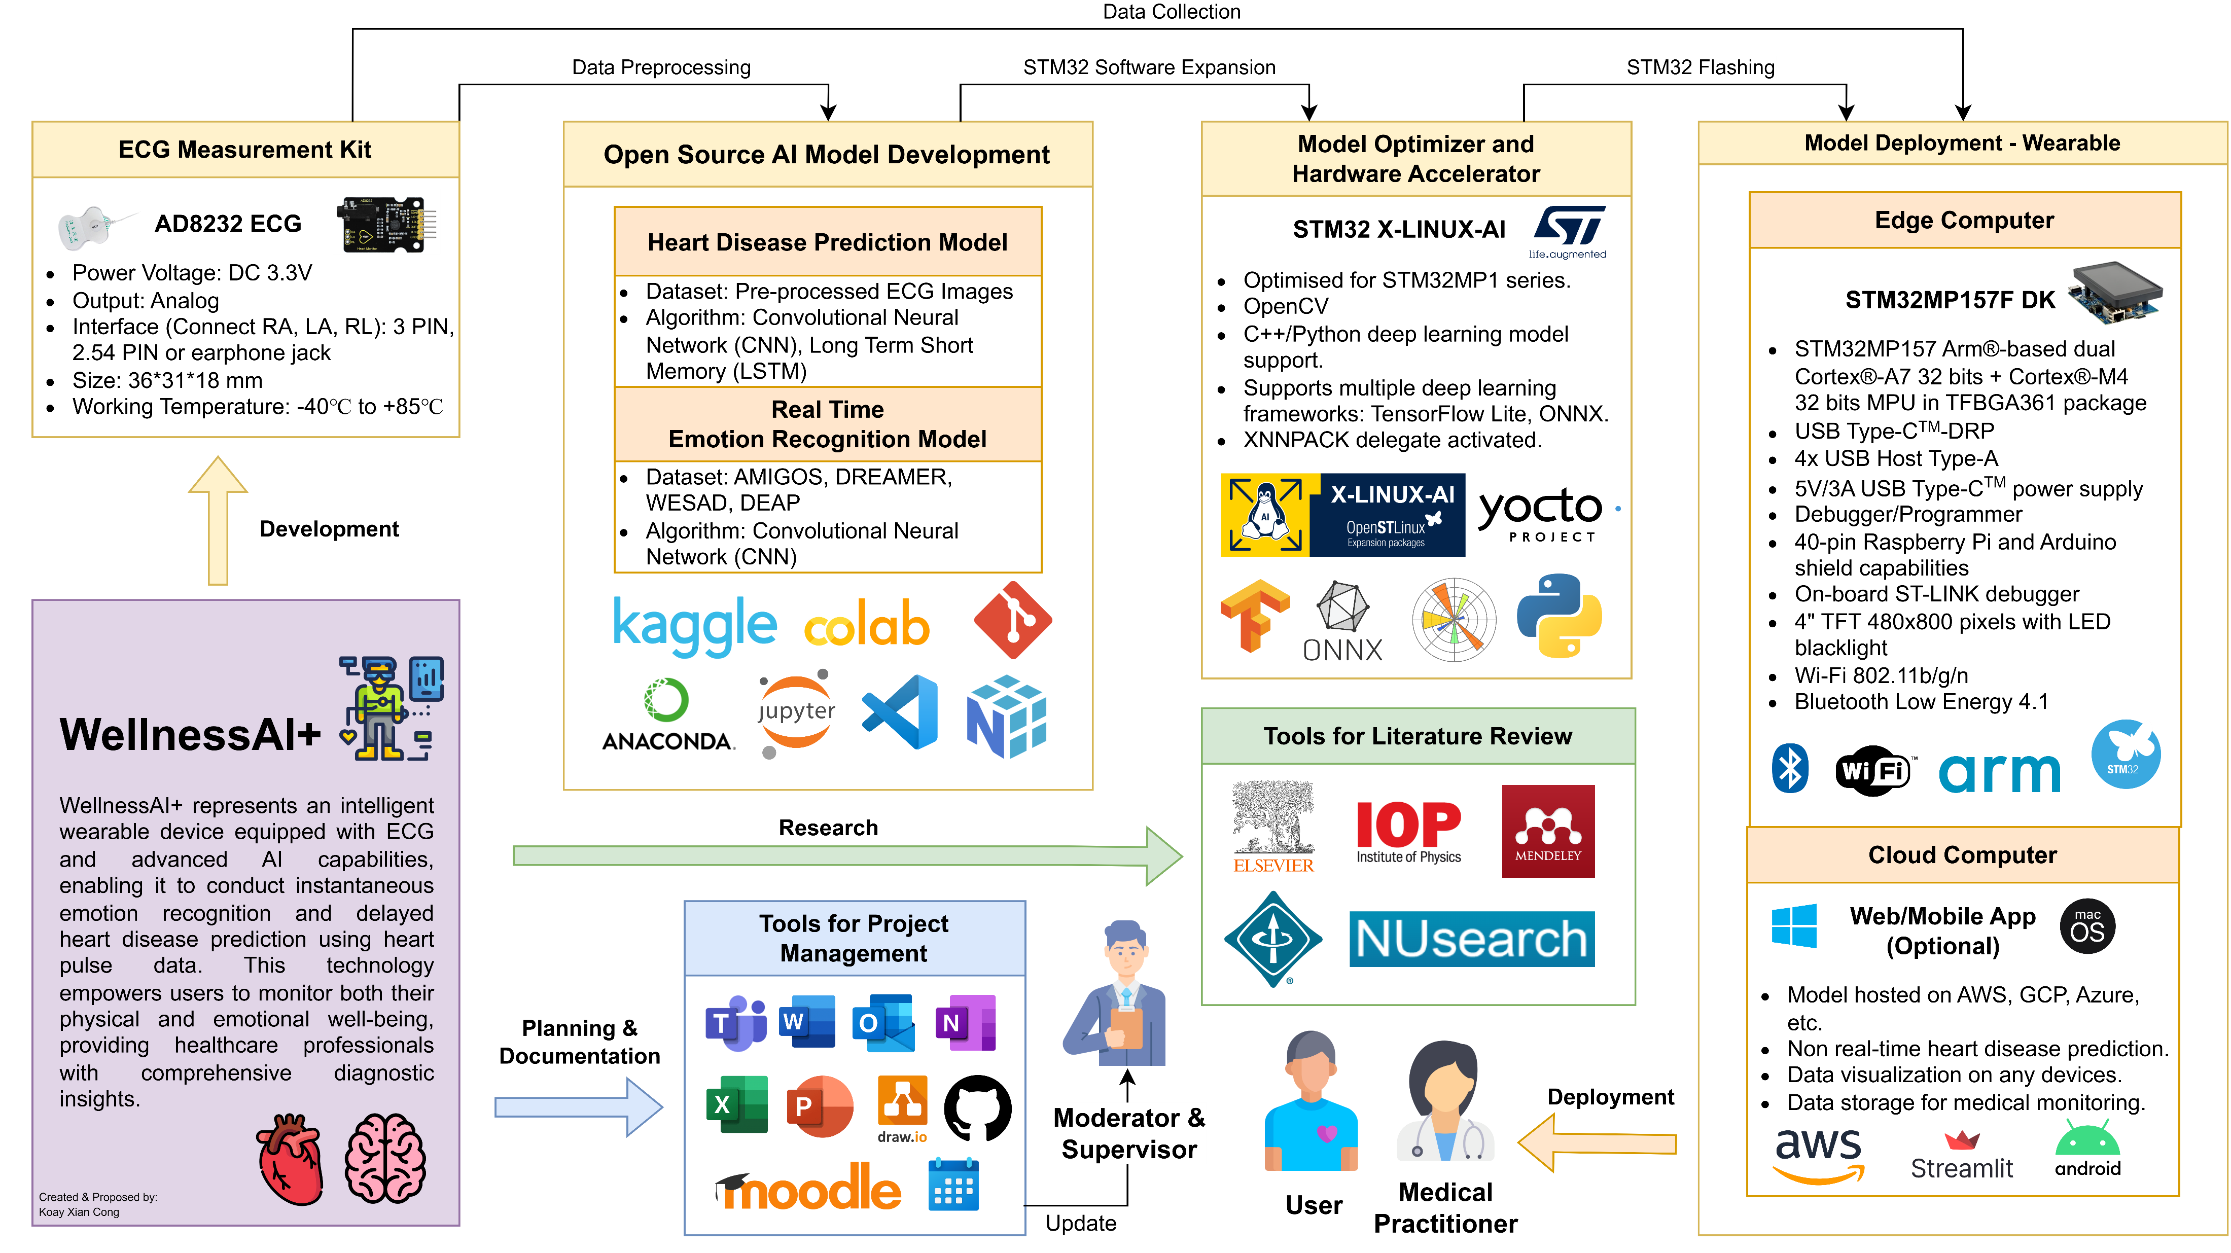

Slide 2
Methods and Approach
Methods | Tools and Approach | Justification | Limitation
Step 1: Setting up Software and Hardware | STM32MP157F-DK2 | Powered by a dual-core ARM Cortex-A7 CPU with an ARM Cortex-M4 STM32MP1 microprocessors are designed for low power consumption, making them well-suited for battery-powered or wearable devices. The presence of an ARM Cortex-M4 microcontroller on the edge computer allows for real-time control and signal processing Comes with a 4” TFT 480x800 pixels with LED backlight | Compared to Raspberry Pi, STM32MP157F-DK2 has fewer readily available resources and support due to smaller communities. STM32MP157D-DK2 is less common and requires sourcing from specific distributors.
 | STM32 Cube programmer | STM32 Cube Programmer is developed and maintained by the manufacturer, ensuring compatibility and reliability. Integrates well with other STM32Cube tools and libraries, streamlining the development process. | STM32 Cube Programmer can be resource-intensive, particularly when working with large projects.
Step 2: Integrating ECG kit onto edge computer. | AD8232 ECG measurement kit | Precise in collecting vital heart activity. | May not be as comfortable for wearables.
Step 3: Open-Source AI Model Development | Python | It has various libraries available for data manipulation, analysis, visualization, etc in AI model development. | Advanced DL models may require substantial computational resources, impacting performance on resource-constraints systems.
 | Anaconda | Provides a convenient environment for managing Python packages and creating isolated development environments | Model is saved locally in the PC.
 | Git/GitHub | Version control system that allows for efficient version tracking in AI model development | Data security and privacy concern.
Step 4: Model Optimizer and Hardware Accelerator. | STM32 X-Linux-AI | Expansion package that targets artificial intelligence for STM32MP1 series microprocessors | limited model architectures available
Step 5: Deployment of AI models into edge computers and cloud computers. | Cloud platforms | Offer access to powerful GPU instances, which significantly accelerate AI model inference and training. Offers APIs to link the results to front-end web/mobile apps. | AI models deployed in the cloud may experience network latency
Notes:
Real time application:
https://wiki.st.com/stm32mcu/wiki/AI:How_to_use_transfer_learning_to_perform_image_classification_on_STM32
https://wiki.st.com/stm32mcu/wiki/AI:How_to_use_Teachable_Machine_to_create_an_image_classification_application_on_STM32

Slide 3
Risk Management and Mitigations
Importance = Severity + Likelihood [Low = 1, Medium = 2, High = 3]. The higher the value, the more important the risk.
Events | Timeline (Week) | Risks | Mitigation | Impact | Pre, Post Mitigation Severity & Likelihood | **
Integrating ECG kit onto edge computer. | 10 – 14 | Incompatibility issue between edge computer and ECG measurement kit. | Perform compatibility testing and refer to hardware documentation. | Delay in project timeline. | Pre: Low Post: Low Likelihood: Low | 3
 |  | Short circuit due to incorrect power connections. | Adhering to the documentation and requirements. | Delay in project timeline if new microcontroller order is needed. | Pre: Medium Post: Low Likelihood: Low | 4
Open-Source AI Model Development | 14 – 28 | Advanced deep learning models may require substantial computational resources, impacting performance on resource-constrained systems. | Optimize and simplify AI models, employ cloud-based resources when necessary, and manage hardware efficiently. | Delayed model training. Performance degradation. | Pre: Medium Post: Medium Likelihood: High | 7
 |  | An exclusive reliance on deep learning methods proved insufficient in identifying all crucial ECG signal features. [9] [7] | A hybrid strategy is applied to improve detection efficiency. [9] | Inaccurate results. Misdiagnoses. | Pre: High Post: Medium Likelihood: High | 8
 |  | ECG signal analysis demands a substantial volume of data for accurate results. [7] | Performing data augmentation to increase the size of the dataset available. | Inaccurate results. Misdiagnoses. | Pre: High Post: Medium Likelihood: High | 8
Deployment of AI models into edge computer and cloud computer | 27 – 31 | The model takes too long to produce output. | Rigorously test AI model deployment on the edge computer to ensure real-time performance and functionality. | Model inaccuracies and reduced usability. | Pre: High Post: High Likelihood: High | 9
 |  | API and model compatibility issues. | Perform test cases with available AI models before training a new model. | Delay in project timeline. | Pre: High Post: Medium Likelihood: High | 8
 |  | Network latency when deployed in the cloud. | Optimize model size. | Delayed response time. | Pre: High Post: Medium Likelihood: High | 8

Slide 4
